Slide 1
Election season
Primary September 1st
State Election November 3rd

Slide 2
The State mailed Postcards to all voters who have not previously requested a mailed ballot
– there is no opt out.
The clerk’s office mails ballots daily.
Wait at least 7 days after your request if you have not gotten your ballot.
If you returned a postcard for all elections and are unenrolled, you were asked to choose a ballot type (Republican or Democrat).If you did not select a ballot, you will not be receiving one in the mail.
You can still vote in person during Early Voting or at the polls.

Slide 3
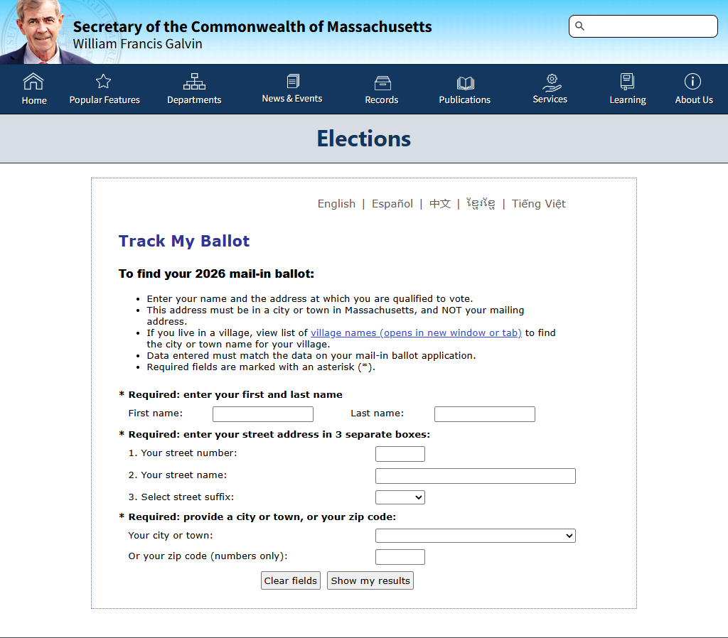
Check the status of your ballot at https://www.sec.state.ma.us/WhereDoIVoteMA/TrackMyBallot

Slide 4
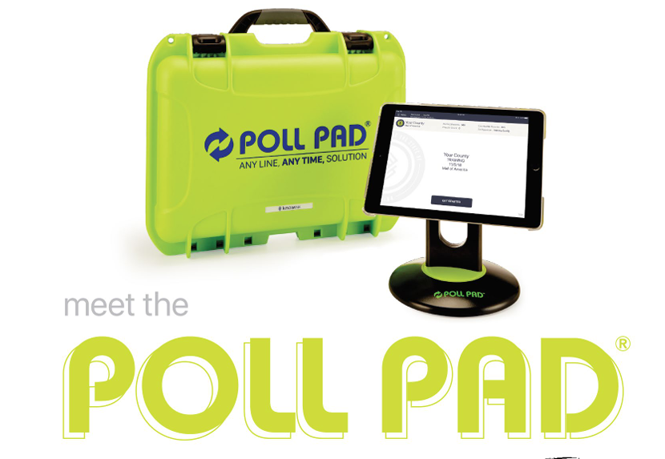
Poll Pads at Early Voting and at the polls

Slide 5
Use of your driver’s license is optional
The back of your license can be scanned to locate your name and address. The poll worker will confirm the information before you are checked in and provided a ballot.
Or they will ask for your name and enter manually.
If you are unenrolled, you must select a ballot for the primary
If you are registered in a party, you can only have that ballot.
If you wish to change parties or become unenrolled, the deadline is Saturday, August 22nd

Slide 6
The Poll Pad does not record votes, count ballots or connect your ballot to your identity. It is simply used to check voters in before they receive a ballot, replacing the paper voter list.
*Faster check-in and more accurate especially with duplicate names (Jr.)*

Slide 7
In-person Early Voting schedule at Town Hall
Saturday, August 22 9am-5pm
Monday, Tuesday, Wednesday and Thursday
August 24-28th 8am-4pm
Absentee is available on Monday, August 31st at clerk’s office 8am-noon.

Slide 8
Primary Election Day,
Tuesday, September 1st
7am-8pm
Edward O’Donoghue Middle School
166 Mt Prospect Street

Slide 9
Unofficial Results will be available the night of the election posted on the Town Clerk’s website
BridgewaterMA.Gov

